Slide 1
State of the Sector 2023

Slide 2
Building Trust & Capacity
Launched early 2020
120 Reporting Requirements to receive Verification: Management, Governance, Financials, Programs, Development
Financials populated from IRS
Process helps build capacity for orgs
Transparency for donors

Slide 3
Building Collaborations & Partnerships
Profiles used in evaluations for The Children’s Trust
Verified profiles were expedited for CARES Act funding for local nonprofits and ARPA funding
Partnering with UF for graduate and faculty research
Hope to partner with more local funders to expedite their grantmaking processes

Slide 4
How Does it Work?
Nonprofits complete their profiles
Community Foundation staff reviews information
The community can fund nonprofits and learn about them
The opportunity to gather information about nonprofits’ management, governance, financials, programs
Allows donors to make stronger giving decisions
Donors can give directly to nonprofits
Completely free of charge for nonprofits and the community

Slide 5
View of the Future
North Central Florida nonprofits recovering, reserves are growing
Tough decisions continue to challenge the sector. Revenue streams are shifting, and diversification is essential.
Transfer of wealth is happening now! A clearly defined planned giving program is critical to sustain the local nonprofit sector.
Increase need to focus on the next generation of philanthropists, meaning new and creative fundraising plans are needed

Slide 6
Hub Data
194 organizations Registered
143 Organizations Verified
* Of organizations reporting; not all organizations registered reported data

Slide 7
Year Over Year
Lost 30 organizations
5 folded /merged
Gained 41 organizations

Slide 8
Sub Sectors

Slide 9
Board Demographics
Female 55%
Male 44%
Other 1%
Alachua County Demographics
Caucasian 60% Black 20% Asian 6% Hispanic/Latino 6% Other 8%
1486 Community Members Serving on Boards 17% have attended The Board Academy

Slide 10
Board Policies
Board Orientation: 82%
Board Assessment: 53%
Conflict of Interest: 85%
Confidentiality: 62%
Review of Bylaws: 79%
Formal Nominating Policy: 67%
Board Diversity Policy: 73%
Strategic Plan: 76%
Succession Plan: 50%

Slide 11
Leadership 94 Paid Full Time Paid Executives
CEO performance review: 89%
Average Years of Experience: 18
Average Years on the Job: 9
Average Age: 48
Annual Compensation*
Under $50,000: 22%
$50,0001 to $80,000: 34%
$80,000 to $100,000: 19%
More than $100,001: 25%
Volunteer Led Orgs: 34%
National Nonprofit Executive Salary Range $70,773 and $102,514
30% increase from 2022
*69 orgs reporting

Slide 12
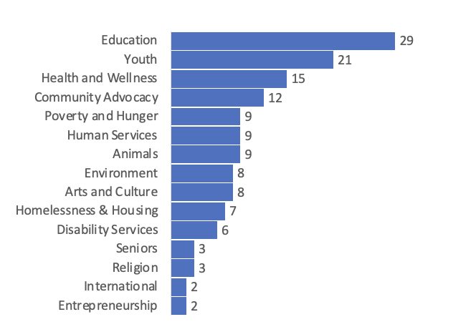
Subsectors with Full Time Paid Staff

Slide 13
Number of Full Time Employees by Subsector
Total Staff 3,071

Slide 14
Staffing
Full Time Staff: 3,071
Part Time: 1,188
Contracted Staff: 163
Interns: 712
Estimated Volunteers a Year: 45,861
Female: 76%
Male: 19%
Other/Not Specified 5%

Slide 15
Staff Policies
Nondiscrimination Policy: 84%
Whistleblower: 62%
Document Destruction: 61%
General Policies: 88%
Staff Confidentiality: 56%
Staff Conflict of Interest: 58%

Slide 16
BIPOC vs. Non-BIPOC
Orgs have full time paid directors
BIPOC: 55%
Caucasian: 68%
Performance Evaluations
BIPOC: 61%
Caucasian: 70%
CEO/Director Salary Average
BIPOC: $71,300
Caucasian: $77,800

Slide 17
Projected Revenues $423,114,855

Slide 18
Endowments and Reserves
Orgs with Endowments: 15%
Totaling $17,284,500
Orgs Reserve Funds: 37%
Averaging $300,000
$600,000 increase over 2022
5% increase over 2022
Only have 7% of needed reserves as a sector

Slide 19
Capital Campaigns
Orgs Currently in a Campaign: 14
Cumulative Goal: $25,780,000
Raised to Date: $7,134,738
Orgs planning to Start in 5 yrs: 38

Slide 20
BIPOC vs. Non-BIPOC
Orgs with Endowments
BIPOC: 0%
Caucasian: 19%
Orgs with Reserve Funds
BIPOC: 15%
Caucasian: 45%
Revenue
Caucasian-led organization have a 60% higher revenue average

Slide 21
Funding by Subsector:
Foundations/Corporations:
Entrepreneurship
Earned Revenue:
Health and Wellness
Individual Gifts:
Community Advocacy
Youth
Disability Services
Grants:
Arts and Culture
Environmental
Homelessness and Housing
Human Services
Animals
Education
International
Religion
Poverty and Hunger
Seniors

Slide 22
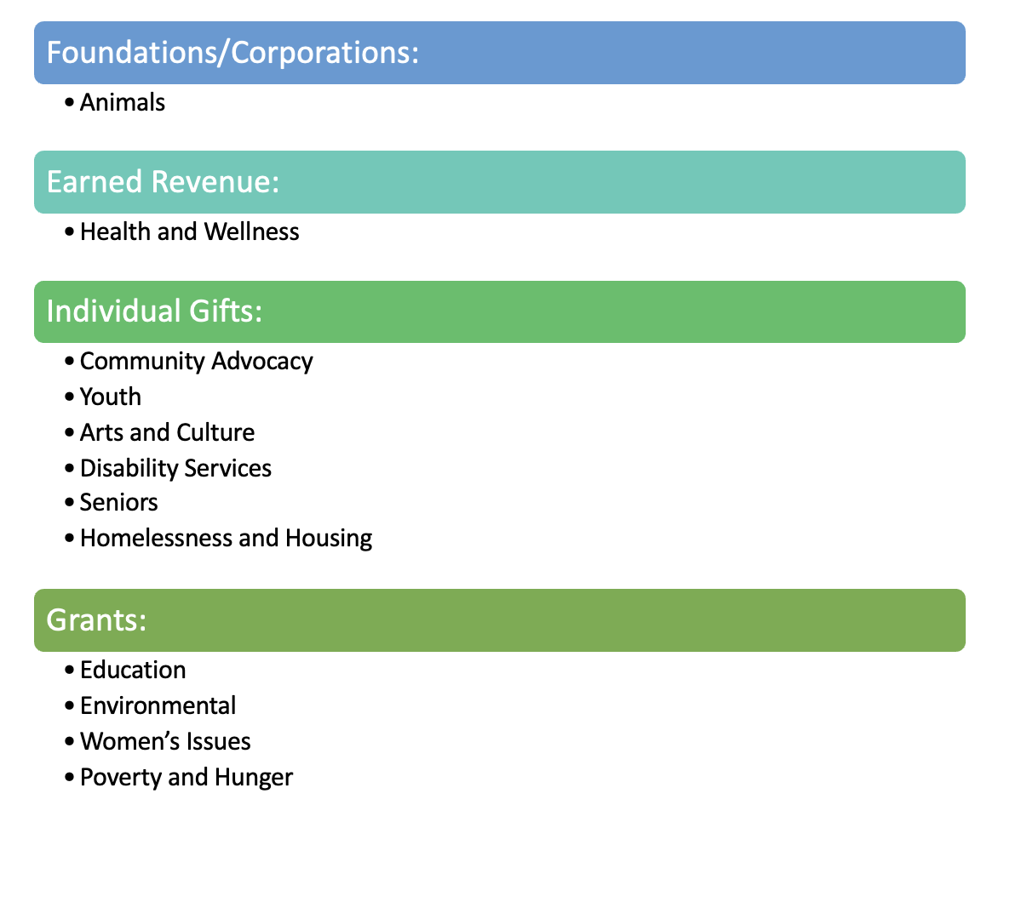
2022
2023
Foundations/Corporations:
Entrepreneurship
Earned Revenue:
Health and Wellness
Individual Gifts:
Community Advocacy
Youth
Disability Services
Grants:
Arts and Culture
Environmental
Homelessness and Housing
Human Services
Animals
Education
International
Religion
Poverty and Hunger
Seniors

Slide 23
Out of the highest 25 operating budgets
Federal/State
Grants
Individual Gifts
Earned Revenue

Slide 24
Out of the lowest 25 operating budgets
Foundations/Corporations
Special Events
Small Grants

Slide 25
Fundraising
62% Development Plan
40% Planned Giving Program

Slide 26
Alachua County’s Current Wealth
$84.6 billion
This includes debt, homes, bank accounts, retirement accounts, closely held family businesses. It does not include or undervalues trusts, hard to value assets, quickly depreciating assets, or extremely high net worth families.
10 Years Ago
$15.4 billion
Notes:
SAMPLE TALKING POINTS:
Household wealth in our region is substantial: it includes homes, accounts, closely held businesses. It also includes adjustments for debt.
Household wealth excludes extremely high net worth households, some trusts, etc.

Slide 27
Alachua County’s Transfer
$10 billion
$3.19 billion
10 Years ago
OVER 10 YEARS
$115 billion
$36.45 billion
STATEWIDE
10 Years Ago
OVER 50 YEARS
Notes:
SAMPLE TALKING POINTS:
We can create scenarios to visualize how wealth will transfer from one generation over time.
These are guesses based on some assumptions about community population change, health, and the economy.
These numbers are substantial.

Slide 28
Interested in Learning More About Planned Giving?
Email LBanis@cfncf.org

Slide 29
Does Our Community Have Too Many Nonprofits?
“Too many” is a qualitative assessment based on individual perceptions. It may reflect concerns about organizations with overlapping missions competing for the same grant money or public support. Or it may just reflect a weariness in receiving so many fundraising solicitations!
Data can’t define what constitutes “too few” or “too many” – but it can let us compare ourselves to peer cities. One data point to consider is whether we have more nonprofit organizations per capita than peer cities.

Slide 30
Does Our Community Have Too Many Nonprofits?
Nonprofits per 1,000 residents

Slide 31
Compared to Larger Cities
Nonprofits per 1,000 residents

Slide 32
Are there too many nonprofits?
How do we address social problems?
How well are we doing at solving the problems that nonprofits are focused on?
What will it take to build a thriving community for all?
Whose responsibility is it to address our community challenges?
Who should pay for the solutions?

Slide 33
A few projections
Giving is becoming more stable
Corporate giving has not caught up with pre-pandemic levels (still!)
Health and environment causes still lead giving in our community
Expecting a ramp up in political giving, causing a slight dip in gifts from individuals.
Planned giving donations are on the rise
Increase in the use of AI in fundraising

Slide 34
Where We Need to Focus
Planned Giving
Human Resources
Governance
Dialogue

Slide 35
Where We Need to Focus: Planned Giving
.17% of the wealth transferring is endowment
.3% is all we have documented for planned giving

Slide 36
Where We Need to Focus: Human Resources
Staff Confidentiality Policy
Staff Whistleblower Policy
Social Media Policy
Compensation

Slide 37
Where We Need to Focus: Governance
Board Assessments
Succession Planning

Slide 38
Diversity is still needed
In two years, we have seen a growth in board diversity
20 orgs reporting all Caucasian, compared to 21 in 2022
6 orgs reporting all Black, compared to 9 in 2022
There is still work to be done to diversify board of directors and staffing in the nonprofit sector.
The Asian Americans and Latin Americans lack voices at the board table
When a nonprofit's board reflects the diversity of the community served, the organization will be better able to access resources in the community through connections with collaborative partners, policy makers, and often, potential donors.

Slide 39
Where We Need to Focus: Dialogue
Major Economic Driver
Major Employer
Solving Major Issues

Slide 41
What’s Next
The Philanthropy Hub re-verification begins on November 1
Look for new fields- ie. planned giving, financial fields
Transfer of Wealth board presentations
Center for Nonprofit Excellence 2024 trainings based on findings

Slide 42
Sources
The Philanthropy Hub
Data USA
Center for Nonprofit Excellence
Tax Exempt World
Salary.com
Giving USA

Slide 43
Let’s Connect
cfncf.org
office@cfncf.org

